Slide 1



SMART INDIA HACKATHON 2026
TITLE PAGE
Problem Statement ID – SIH26205
Problem Statement Title- AI- Powered Skill Gap Analysis and Carrer Guidance System
Theme- Smart Education
PS Category- Software
Team ID-
Team Name - InfoSnatcher

Slide 2

IDEA TITLE
InfoSnatcher
USP: “Right Skill → Right Student → Right Job”
❖Proposed Solution
•🎯 Skill-First Evaluation – Beyond CGPA & certificates.
•🤖 AI Skill Profiling – Identifies real strengths & abilities.
•🔗 Smart Job Matching – Matches students with industry needs.
•📊 Skill-Gap Analysis – Finds missing skills for each role.
•💡 Personalized Learning – Recommends skills to improve.
•🏆 Hidden Talent Detection – Identifies potential beyond marks.
•🔍 Explainable Ranking – Shows why a candidate is recommended.
@SIH Idea submission
2
Notes:
2

Slide 3
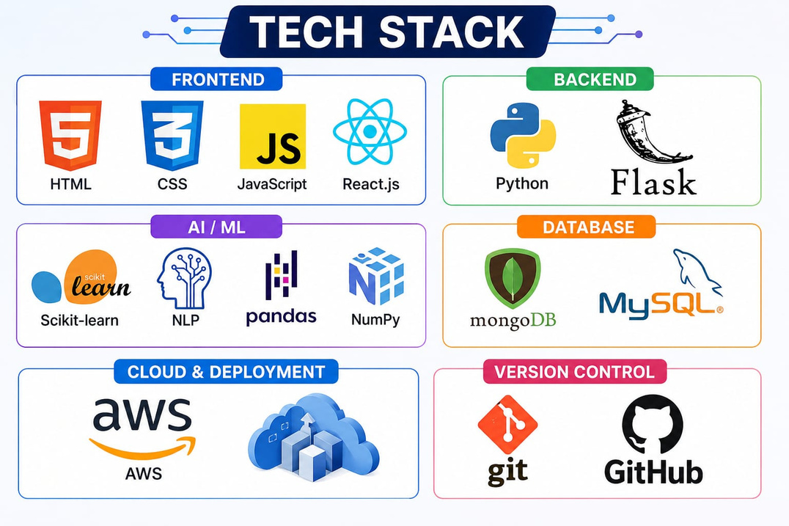
TECHNICAL APPROACH
InfoSnatcher
🛠️ Technology Stack
Frontend: HTML5, Tailwind CSS, JavaScript
Backend & APIs : Python , FastAPI , Pydantic ,Uvicorn
AI & LLMs: Groq API, Google Gemini, Multi-model Fallbacks
Database:Supabase, PostgreSQL, Row Level Security(RLS)
Version Control: Git, GitHub
🔄 Methodology & Process
Data Collection → Data Preprocessing → Skill Extraction → AI Assessment → Skill-Gap Analysis → Job Matching → Career Recommendation
🚀 Implementation
AI-based skill assessment
Industry requirement analysis & intelligent skill–job matching
@SIH Idea submission
3
Notes:
3

Slide 4
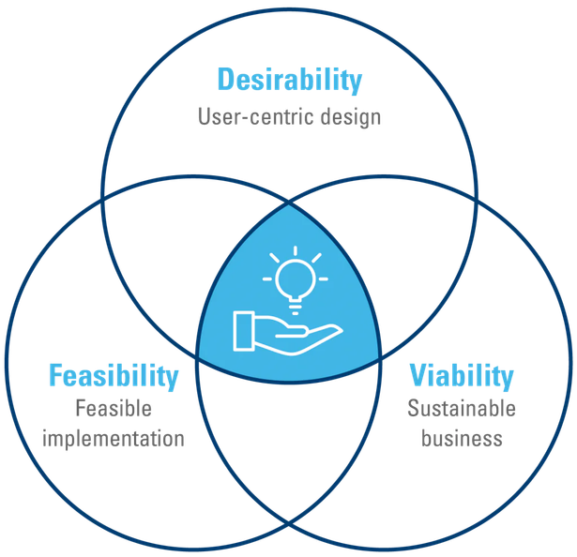
FEASIBILITY AND VIABILITY
InfoSnatcher
✅ Feasibility
AI/ML technologies are readily available
Uses existing student & job-skill datasets
Scalable for colleges and institutions & Can integrate with college placement systems
⚠️ Challenges
Data privacy & security
Limited/inconsistent student skill data
Changing industry skill requirements & Risk of biased recommendations
🛠️ Mitigation
Secure & anonymize student data
Continuous model & skill-data updates & Use validated assessment methods
Regular bias & accuracy checks
🚀 Viability
Low-cost • Scalable • Industry-relevant • Long-term impact
@SIH Idea submission
4
Notes:
4

Slide 5

IMPACT AND BENEFITS
InfoSnatcher
🎯 Right Skill → Right Career
Identifies students’ actual skill potential
Reveals skill gaps & learning needs
Matches talent with suitable industry roles
Reduces skill–job mismatch
Improves employability & placement outcomes
Supports data-driven career decisions
Helps industries find better-fit candidates
Impact: 🚀 Skilled Students • Smarter Hiring • Stronger Workforce
@SIH Idea submission
5
Notes:
5

Slide 6
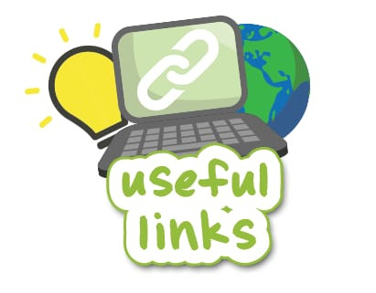
RESEARCH AND REFERENCES
InfoSnatcher
🌐 World Economic Forum — Future of Jobs Report 2025
Skills trends, job-market changes & industry requirements
[WEF Report](https://www.weforum.org/publications/the-future-of-jobs-report-2025/digest/)
🛄 O*NET — Occupational Skills Database
Skills, abilities & job-role mapping
[O*NET Database](https://www.onetcenter.org/database.html)
🇮🇳 National Skill Development Corporation (NSDC)
Indian skill-gap & employability data
[NSDC](https://nsdcindia.org/)
📻 IBM SkillsBuild
Industry-aligned skills & career learning pathways
[IBM SkillsBuild](https://skillsbuild.org/)
🌍 WEF — Skills Outlook 2025–2030
AI, big data, cybersecurity, analytical & creative skills
[SkillsOutlook](https://skilloutlook.com/)
@SIH Idea submission
6
Notes:
6

